Slide 1
Handwriting Personality Prediction
Group B1: Kaushik Kumaran, Hyeon Gu (Grant) Kim, Lucy Hwang, Yashaswini Kalva, Archit Patel

Slide 2
Introduction

Slide 3
Overview
Applications
Problem Statement
Psychological analysis
Graphology is used clinically by counsellors and psychotherapists.
A system is proposed to automate the basic handwriting analysis tasks of graphology to determine a few important personality traits.
Employment profiling
A graphological report is meant to be used in conjunction with other tools, such as comprehensive background checks, practical demonstration or record of work skills.
Notes:
Graphology is a method of identifying, evaluating and understanding human personality traits through the strokes and patterns revealed by handwriting.
An employer needs to understand the employees they hire; a counsellor needs to understand his/her client; an individual needs to understand his/her friends for a good and long-lasting relationship.

Slide 4
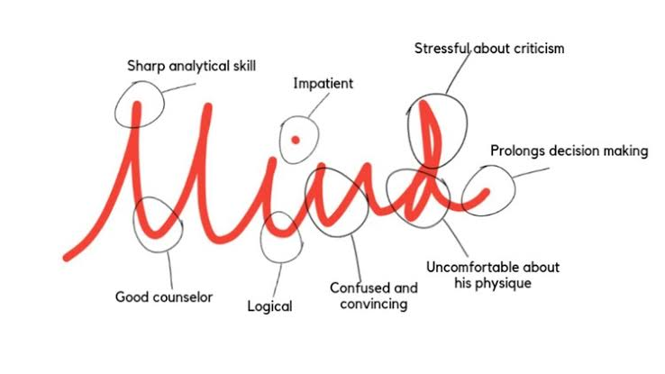
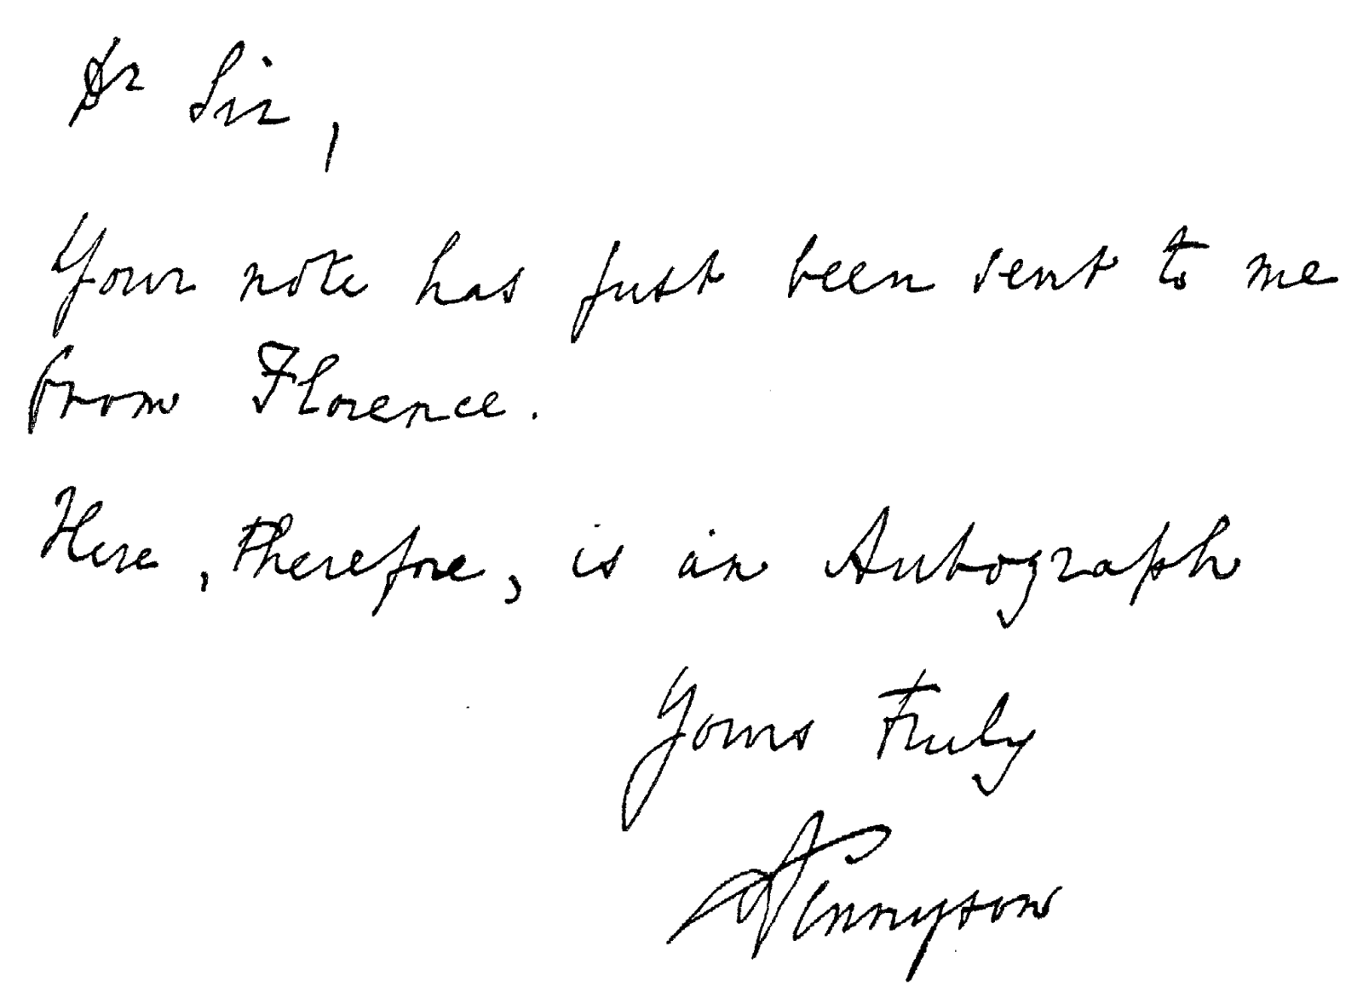
Analysis example
Analysis example
Sample walkthrough
Sample text
1
Alignment and size of letter
2
Match the template
3
Spacing

Slide 5
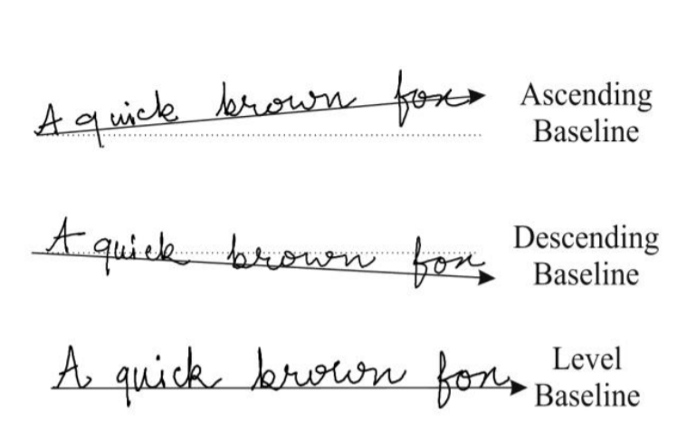
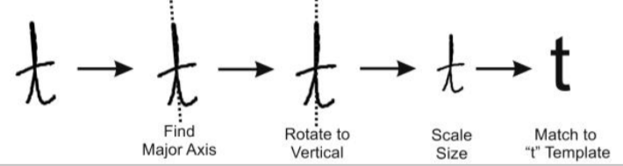
Feature examples
Alignment and size
Alignment
Ascending baseline
Descending baseline
Level baseline
Size

Slide 6
Data sourcing and cleaning
Data sourcing
Data cleaning
Methods
Data from the IAM Handwriting Database of Research Group on Computer Vision and Artificial Intelligence INF, University of Bern, Switzerland is obtained.
Image Resolution and Cropping
Data input
The original images contain unwanted printed texts, lines and free space which are not suitable for further processing. We will be writing a script to crop out the left and right margins, resize all the images with 850 pixels width and perspective height, and save the images in PNG format.
IAM Handwriting Database of Research Group
Preprocessing
672 pages of scanned text
Feature extraction
Training the classifier
Noise Removal
Image noise is defined as random variation of brightness or colour information in images. Noise can be removed by filtering the images.
Predict personality traits
Notes:
Random forest - pre processing and extracted features but for CNN and ANN this pre-processing is not required

Slide 7
Handwriting features
Attribute
Writing categories
Psychological personality behavior
Letter size
Large letters
Likes being noticed, stands out in a crowd
Small letters
Introspective, not seeking attention, modest
Average letters
Adaptable, fits into a crowd, practical, balanced
Letter slant
Right slant
Sociable, responsive, interested in others, friendly
Left slant
Reserved, observant, self-reliant, non-intrusive
Vertical slant
Practical, independent, controlled, self-sufficient
Pen pressure
Light pen pressure
Can endure traumatic experiences w/o seriously affected.
Heavy pen pressure
Have very deep and enduring feelings
Baseline
Raising baseline
Optimistic, upbeat, positive attitude, ambitious and hopeful
Falling baseline
Tired, overwhelmed, pessimistic, not hopeful
Straight baseline
Determined, stays on track, self-motivated, reliable, steady
Erratic baseline
Wavering, lacks definite direction, unpredictable
Word spacing
Far spaced words
Desires more space, enjoys privacy
Close spaced words
Closeness of sentiment and intelligence
Notes:
Random forest

Slide 8
Labels
Agreeableness
Neuroticism
Openness
Consciousness
Extraversion
Notes:
Everything

Slide 9
Modeling

Slide 10
Model overview
CNN
The input image is fed into the CNN layers. These layers are trained to extract relevant features from the image.
ANN
Computational models inspired by an animal's central nervous systems. It is capable of machine learning as well as pattern recognition
Random forest
An ensemble learning method for classification, regression and other tasks that operates by constructing a multitude of decision trees at training time.

Slide 11
CNN Methodology
Data Preprocessing
Separated the data into training set, validation set, and test set samples
Data Augmentation was used to increase the number of samples
Model Building
Transfer learning was used to learn the lower level features
The base model was InceptionResnetv2 with pre-trained weights flowing in from ImageNet dataset
The base model was followed by Max Pooling, Dropout, Batch Normalization and a fully connected layer of 50 units
Model Features
Relu activation function for the hidden layers
SoftMax activation is used for the output layer
Adam Optimization is used for Gradient Descent
Incorporated model checkpoints to store the best weights
Hyperparameter Tuning
Epochs: set the number of epochs to 30
Batch size: tried batch sizes of 16, 32, and 64
Learning rate: 0.001

Slide 12
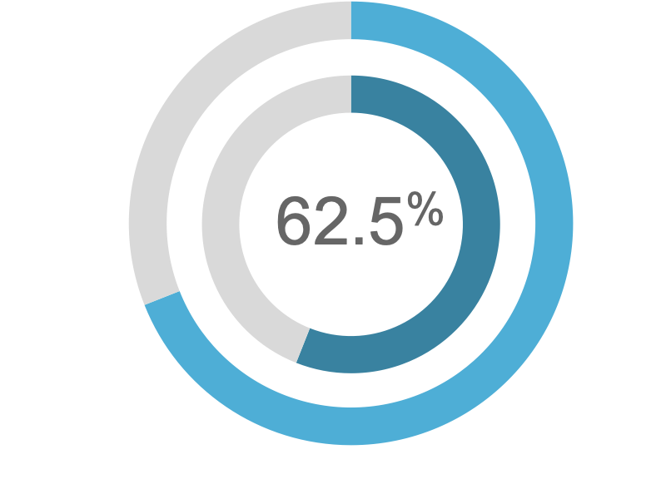
CNN Results and Next Steps
Results
Accuracy on the training set - 78.9%
Accuracy on the validation set - 65.3%
Accuracy on the test set - 62.5%
Next steps
Unfreeze certain layers and try re training the model with our dataset for those layers
Try other architectures which could potentially outperform Inception Resnet V2 for the given dataset
Augment the data further for the imbalanced classes.
Also tune parameters like the optimizer, number of layers etc

Slide 13
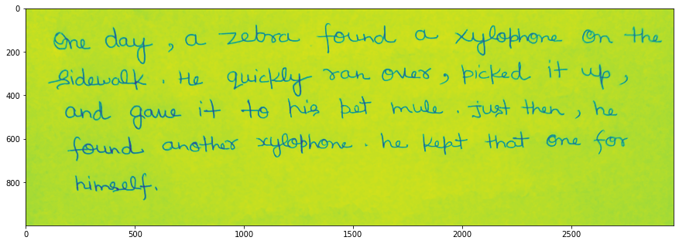
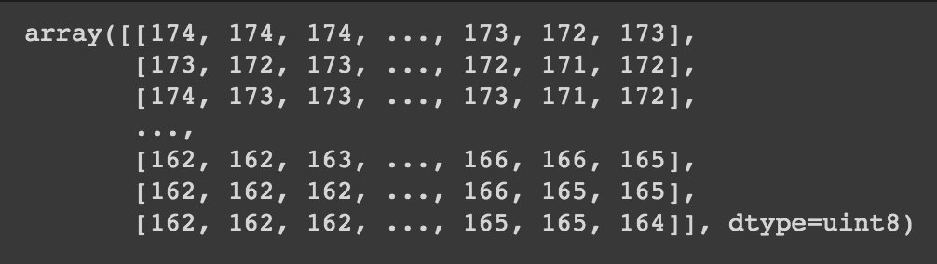

ANN
Sample text
Arrays of Pixels
ANN
Notes:
This is basically a high level view of the process of ANN.
With datasets of handwriting images, we converted them into arrays of pixels and put them into ANN model.

Slide 14
ANN
Data Preprocessing
Encoded the data
Splitted the data into train, validation, and test data sets
Model Building
Rescaled and flattened the data
ReLU activation function for the hidden layers
Softmax for the output layer
Regularized each hidden layers to prevent overfitting.
Model Features
Sparse Categorical Cross entropy loss function
RMSprop optimizer
Hyperparameter Tuning
Epochs: 60
Batch size: tried batch sizes of 16, 32, and 64
Notes:
Here is detailed process of ANN.
Data preprocessing
Where we encoded the data and splitted into train, validation and test data sets
Model Building
2 hidden layers with 2 dropout layers for regulization
4 output layers

Slide 15
ANN
Data Preprocessing
Encoded the data
Splitted the data into train, validation, and test data sets
Model Building
Rescaled and flattened the data
ReLU activation function for the hidden layers
Softmax for the output layer
Regularized each hidden layers to prevent overfitting.
Model Features
Sparse Categorical Cross entropy loss function
RMSprop optimizer
Hyperparameter Tuning
Epochs: 60
Batch size: tried batch sizes of 16, 32, and 64
Notes:
113 input nodes
2 hidden layers with 128 and 64 nodes
4 output layers
Why those num of layers?
Why ReLU? -> need activation fn for SGD w/ backpropagation to train deep NN -> ReLU = act like linear fn but actually nonlinear fn
Computationally simple (while tanh & sigmoid fn require exponential calculation, ReLU only requires max() fn.
Can represent “true zero” (tanh%sigmoid just output results that are close to zero not true zero)
Easier to optimize due to its linearity (avoids vanishing gradient problem where the weights become so small and cause inefficient GD)
Why Softmax?
react to low stimulation (think blurry image) of your neural net with rather uniform distribution and to high stimulation (ie. large numbers, think crisp image) with probabilities close to 0 and 1.
Linear and Sigmoid activation functions are inappropriate for multi-class classification tasks
Why Sparse Categorical Cross entropy loss func? -> bc it is multi-class classification problem
Why RMSprop optimizer? -> adaptive learning optimization algorithm -> adapts as it moves down to minima (adapts learning rate -> momentum) Let’s try ADAM next time
Why those num of epochs and batch sizes?Trial and error -> Batch size = 32 was the best

Slide 16
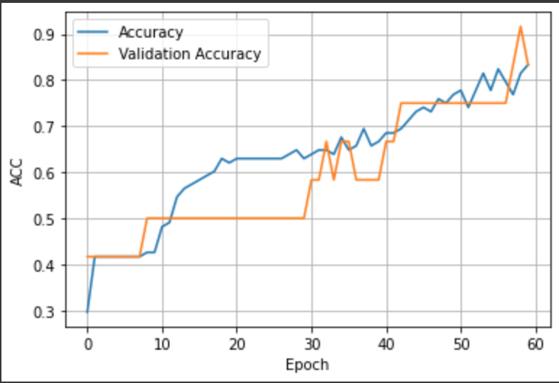
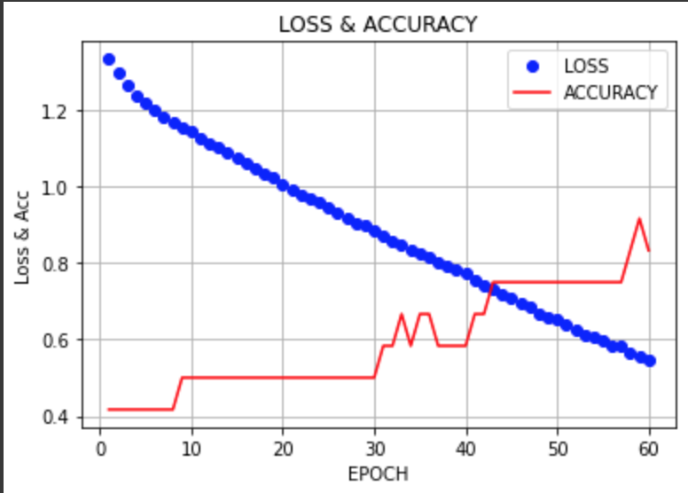
ANN
Model accuracy
Accuracy on the training set - 83%
Accuracy on the validation set - 83.3%
Accuracy on the test set - 79%
Notes:
We can observe that the model accuracy increases and the loss is decreases as the number of epoch increases.

Slide 17
ANN Challenges and Next Steps
Challenges
Tabular Data Input
Hard to Interpret
Next Steps
Try Different Hyperparameters
ADAM optimizer
Notes:
Challenges: ANN only takes tabular data input -> not the best method to read and predict images (converting 2D image to 1D arrays)
No specific output or evidence why the model is getting such result.
Next Step: We definitely need more investigation on ANN and figure out the way to improve the accuracy.
We are gonna try diff hyperparameters: We will explore further on num of epochs and batchs, We will try ADAM optimizer instead of RMSprop and see if it outputs better results.
We will also try tune the number of layers and nodes and see if it outputs better results.

Slide 18
Pre-processing and data cleaning
Data cleaning
Data input
Preprocessing
Feature extraction
Training the classifier
Predict personality traits

Slide 19
Pre-processing and data cleaning
The handwriting images we obtained contains unwanted noise, printed texts and lines
The aim of pre-processing is to make the image data suitable for feature extraction
No.
Pre-processing stages
Pre-processing steps
1
Image resolution and cropping
Crop left and right margins
Resize the images with 850 pixels width
2
Noise removal
Bilateral filter
3
Grayscale and binarization
Converted to grayscale
Binarized using inverted global thresholding
4
Contour and transformation
Straightening using dilation
Find the contours
Affine transformation
5
Horizontal and vertical projections
Horizontal projection: list of sum of all the pixel values of each row of the image
Vertical projection: list of sum of all the pixel values in each column of the image
Notes:
Image resolution and cropping
Noise removal
Grayscale and binarization
Contour and transformation
Horizontal and Vertical Projections
Image resolution and cropping:
Cropped out the left and right margins
Resized all the images with 850 pixels width and corresponding height
Noise Removal:
We removed noise from images for efficient feature extraction.
For that we used Bilateral filter to preserves the edges
A bilateral filter is a non-linear, edge-preserving, and noise-reducing smoothing filter for images.
It replaces the intensity of each pixel with a weighted average of intensity values from nearby pixels. This weight can be based on a Gaussian distribution.
GrayScale and binarization:
We then converted the colored images to grayscale
and also applied binarization to either have 0 or 255 for each pixel based on threshold values
Contouring and transformation:
Dilation
Warp transformation is applied to rotate the contoured images to make baseline of the images strictly horizontal. The angle of the rotational transformation is preserved as this is one of the features used for assesing the personality trait
Horizontal and vertical projections:
In context of this project,
the horizontal projection of an image is a python list of sum of all the pixel values of each row of the image,
while vertical projection is a python list of sum of all the pixel values of each column of the image
Both of these operations are performed on grayscale images

Slide 20
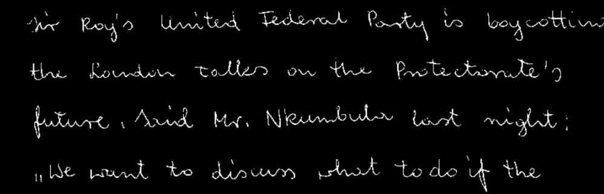

Pre-Processing
Inverted Binarization
Dilation
Notes:
Inverted binary thresholding is done on the image to convert to binary image with a threshold of 120. Now the background pixels are black and the foreground (handwriting) pixels are white.
Dilation is done on the image from step 1 with a 5x100 kernel so that each line is resulted into a think horizontal segment
Minimum area rectangle function of OpenCV takes an contour object and returns the angle the object makes with horizontal line.
The average of the angles of all the contours is taken as the baseline angle, our first feature.
This operation helps to maximize effectiveness of operations involving horizontal projection.

Slide 21
Handwriting features
Attribute
Writing categories
Psychological personality behavior
Letter size
Large letters
Likes being noticed, stands out in a crowd
Small letters
Introspective, not seeking attention, modest
Average letters
Adaptable, fits into a crowd, practical, balanced
Letter slant
Right slant
Sociable, responsive, interested in others, friendly
Left slant
Reserved, observant, self-reliant, non-intrusive
Vertical slant
Practical, independent, controlled, self-sufficient
Pen pressure
Light pen pressure
Can endure traumatic experiences w/o seriously affected.
Heavy pen pressure
Have very deep and enduring feelings
Baseline
Raising baseline
Optimistic, upbeat, positive attitude, ambitious and hopeful
Falling baseline
Tired, overwhelmed, pessimistic, not hopeful
Straight baseline
Determined, stays on track, self-motivated, reliable, steady
Erratic baseline
Wavering, lacks definite direction, unpredictable
Word spacing
Far spaced words
Desires more space, enjoys privacy
Close spaced words
Closeness of sentiment and intelligence

Slide 22
Feature Extraction
Baseline
Letter Size
Line Spacing
Word Spacing
Top Margin
Pen Pressure
Slant of Letters
Notes:
There are numerous handwriting characteristics, simple and complex, a graphologist may use to predict the psychological state of a writer. Out of them, 7 features which are deemed to be significant are selected to be extracted . We will discuss them one by one

Slide 23
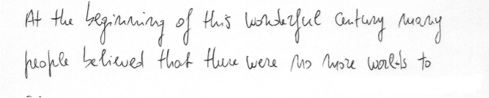
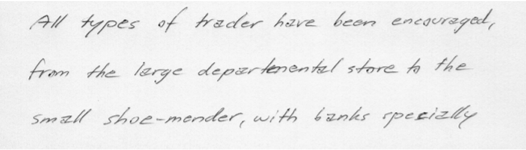
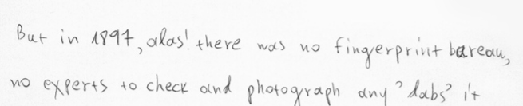
Baseline
Normal
Rising
Falling
Notes:
As an indicator of mood, moral and social control, temperament, disposition and flexibility, the baseline is the ego-adjustment line. Normally Straight Lines: Composure, orderliness, emotional stability. Rising: Buoyant spirit, ambition, optimism, restlessness Falling: Neuroticism, Fatigue, depressions, disappointment, unhappiness
a point of reference that is used for comparison purposes, its where most letters reside.

Slide 24
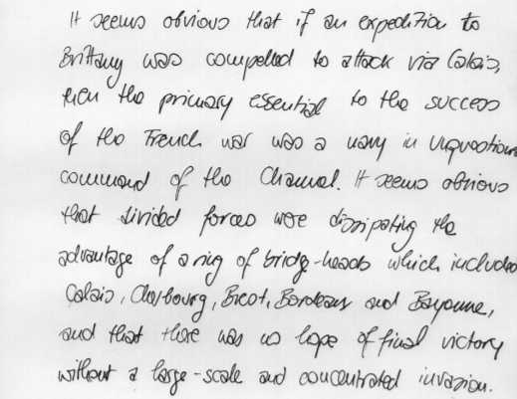
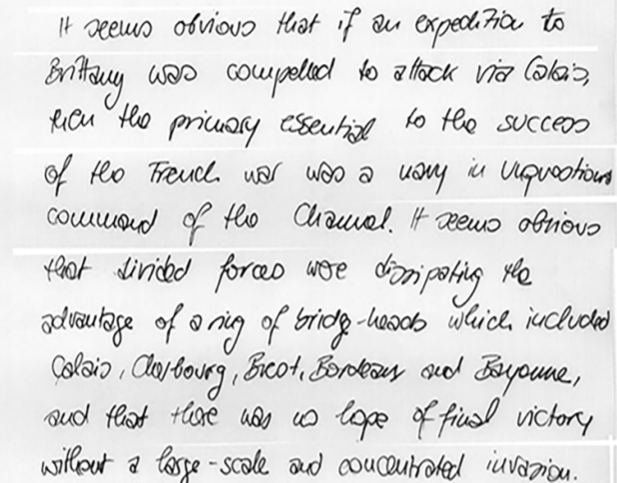
Affine & Warp Transformation
Before
After

Slide 25
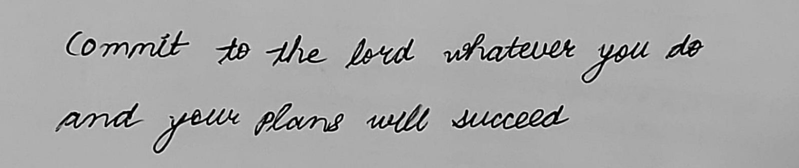
Extracting Lines
Horizontal Projection
Notes:
The horizontal projection of an image is a python list of sum of all the pixel values of each row of the image. This is performed on the grayscale image
The straightened image resulted from the extraction of baseline is taken and its horizontal projection is found out into a python list - hpLis
The hpList is scanned topdown. Some values of horizontal projection may be 0 which represent blank space rows. A row with non-zero hpList value constitutes a pixel row encountering at least one foreground pixel (contour). Each contour is identified from the start of a non-zero value to the next zero value

Slide 26
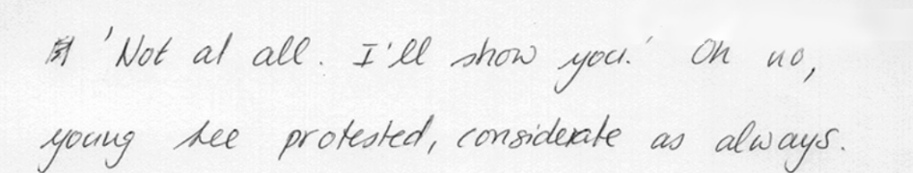
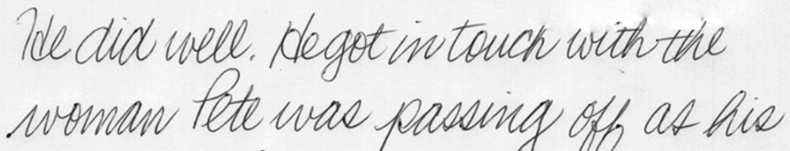
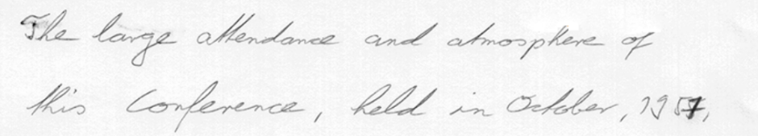
Letter Size
Normal size
Large size
Small size
Notes:
Letter size is estimated by scanning the horizontal projection of each line extracted in the previous algorithm. The number of consecutive rows having projection value greater than a threshold is counted. The average letter size of all the lines will be our letter size
Normal Size - Adaptable, Normal State of Mind
Large Size - Enjoy Attention, Act with Boldness and Enthusiasm
Small Size - Not very communicative
3 to 5 mm is fine
I mm = 3.77 pixel

Slide 27
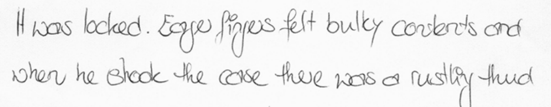
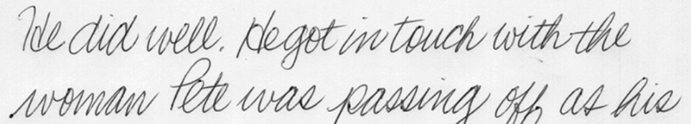
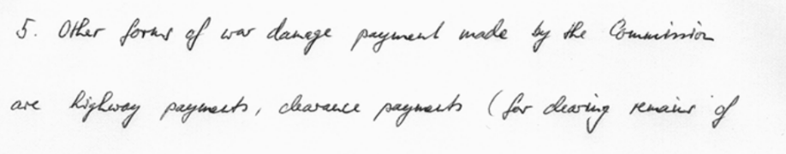
Line Spacing
Normal Spacing
Crowded Spacing
Crowded Spacing
Large Spacing
Notes:
The amount of space the writer leaves between the lines on the page.
. The total number of rows with horizontal projection 0 is counted, except the top margin. Lets call it a.
. The total number of rows with horizontal projection less than a threshold is counted in the extracted lines. Lets call it b.
Let n be the number of extracted lines in the document. The entity x = a + b / n
The final line spacing is taken as x divided by the letter size, so that it is relative to the size of the handwriting
2 to 3.5
Normal Spacing - Writer has his own personal harmony and fexibility
Crowded Spacing: Thoughts and feelings are confused
Large Spacing:
The person is isolating himself from his environment, socially.

Slide 28
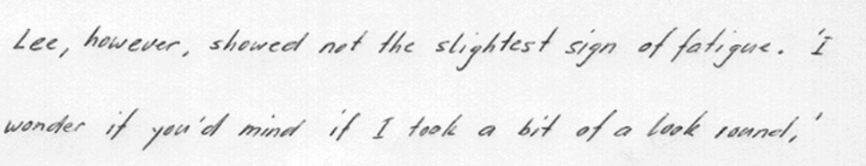
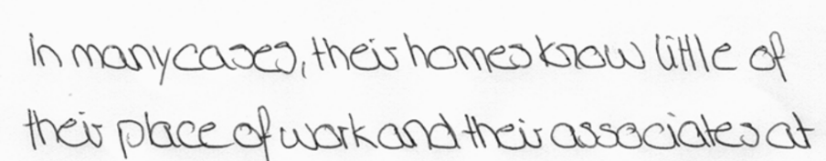
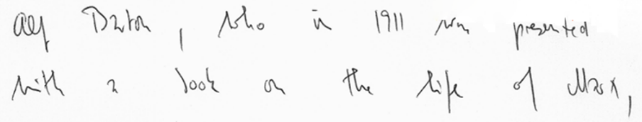
Word Spacing
Normal Spacing
Narrow Spacing
Wide Spacing
Notes:
The space between the written words represents the distance that the writer would like to maintain between himself and society at large
1.The vertical projection of each line of the image is computed into a python list (array).
2. The number of columns in the list with value of 0 (column with all pixels value 0, that is empty area) is counted, except the left and right margin. Let it be a
3. The number of runs of non-zero columns will give the number of words or disconnected letters. Let it be b
4. x = a/b gives the average word spacing of the handwriting.
5. The average of these x ’s of all the lines are found. Let it be y. The word spacing is taken as y divided by the letter size, so that it is relative to the size of the handwriting
Normal Spacing: will be able to deal with flexibility and objectively with others and himself
Narrow Spacing: Will be attention seeker, can be selfish sometimes and not give space to others.
Wide Spacing: It indicates that writers need to maintain his distance from social contact, either due to inner need for privacy.
1.2 to 2

Slide 29
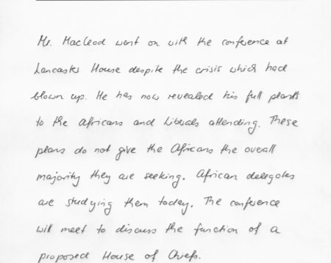
Top Margin
Top Margin
Notes:
In order to extract the top margin, we simply scan the horizontal projection of the image from top for the first run of 0 ’s. The number of 0 ’s is the height of the top margin, which is again divided by the letter size so that it is relative to the handwriting size.
Narrow Top Margin: Directness in approach, lack of respect
Wide Top Margin: Modesty, Formality Respect shown for others

Slide 30
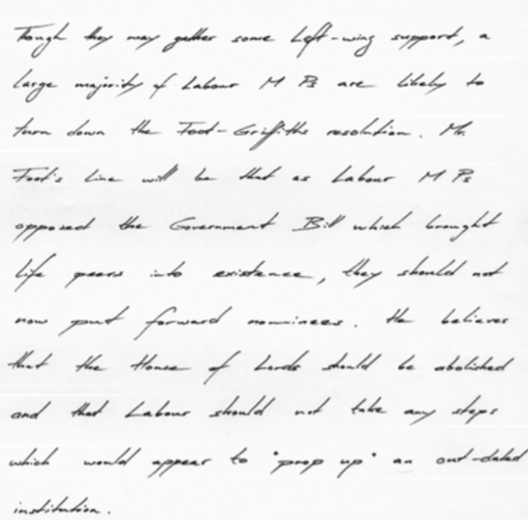
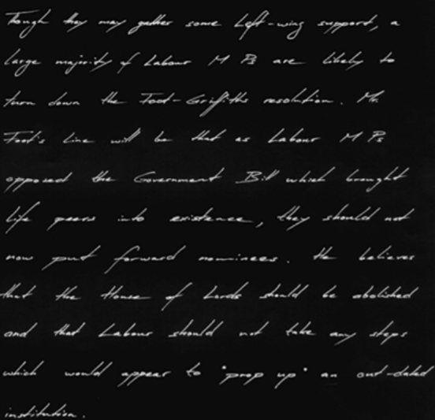
Pen Pressure
Normal
Inverted
Notes:
An inverted binary threshold (THRESH TOZERO) is performed where if src(x, y) is lower than threshold=100
The average value of all the non-zero pixels is taken as the pen pressure.
Heavy pressure: strong willed, easily excited, Negative side can be stubborn, but can inspire others
Light Pressure: Sensitive, Less will power, far more tolerant
Medium Pressure: Healthy vitality and will power

Slide 31
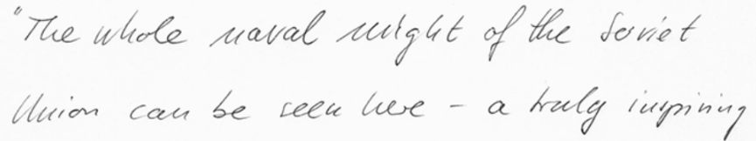
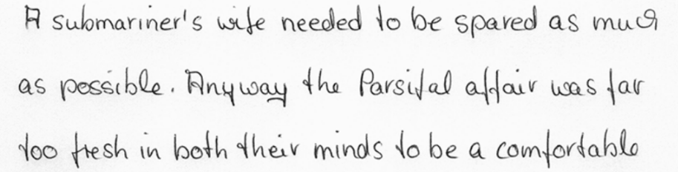
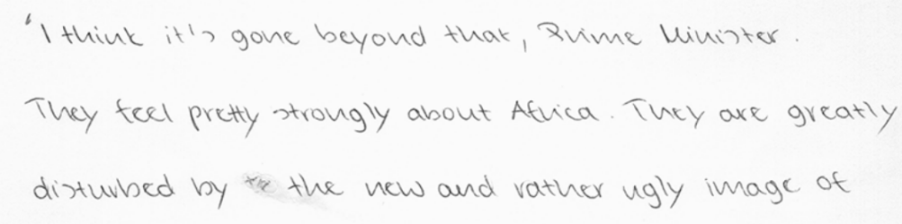
Slant of Letters
Inclined
Normal
Reclined

Slide 32
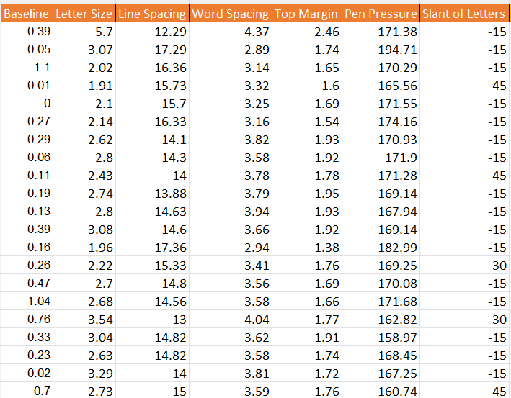
Processed Data

Slide 33

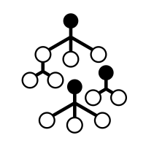
Random Forest
Openness
Conscientiousness
Extraversion
Agreeableness
Neuroticism
Baseline
Slant of letters
Letter size
Line spacing
Letter size
Pen Pressure
Top Margin
Letter Size
Baseline
Slant of letters
Notes:
Most important features for Openness were Baseline and Slant Height.
Most important features for Conscientiousness were letter size and line spacing
Most important features for Extraversion were letter size and Pen Pressure
Most important features for Agreeableness were Top Margin, Letter Size
Most important features for Neuroticism were Baseline, Slant Height

Slide 34
Random Forest
Openness
Conscientiousness
Agreeableness
Neuroticism
Baseline
Slant of letters
Letter size
Line spacing
Top Margin
Letter Size
Baseline
Slant of letters
Notes:
Most important features for Openness were Baseline and Slant Height.
Most important features for Conscientiousness were letter size and line spacing
Most important features for Extraversion were letter size and Pen Pressure
Most important features for Agreeableness were Top Margin, Letter Size
Most important features for Neuroticism were Baseline, Slant Height

Slide 35
Conclusion

Slide 36
Key takeaways
Pre-processing is a key step for accuracy
Hyper parameter tuning importance
Notes:
CNN, ANN has 63% and 73% respectively. Preprocessing has a major role to play - post that for random forest we are getting 95% accuracy.

Slide 37
Insights from our data

Slide 38
Key limitations
Extreme cases
Sample limitation
ANN trainable parameters
Notes:
Nevertheless, the feature extraction techniques may not be able to handle every extreme cases of handwriting styles and such cases may yield inaccurate results,
Enhance the algorithms to handle extreme cases of handwritings to achieve more accuracy. Eg Overlapping lines
Limitation on Samples
ANN - The number of trainable parameters increases drastically with an increase in the size of the image
ANN loses the spatial features of an image. Spatial features refer to the arrangement of the pixels in an image. (input=tabular data)

Slide 39
Looking forward
Next steps:
Neural Net to Extract Features
ROC
CNN next steps
Add more features
Plan to test professor’s handwriting
Notes:
Neural nets
ROC for random forest,
Add more features

Slide 40
Looking forward
To-do list
ROC
Computation and manual effort
Neural Net to Extract Features
Plan to test professor’s handwriting

Slide 41
Thank you, Questions?

Slide 42
Appendix

Slide 43
Feature examples
bars
Template matching
curviness
loop

Slide 44
Overview
Applications
Problem Statement
Psychological analysis
A system is proposed to automate the basic handwriting analysis tasks of graphology to determine a few important personality traits.
Seven features/characteristics of a handwriting are considered to be extracted from a sample handwriting image.
Each of the seven resulting raw values will be put into corresponding categories of respective feature variations. A combination of these discrete values will be used to train each support vector machine for a personality trait. The classifier will then be able to predict the personality traits of the writer
Graphology is used clinically by counsellors and psychotherapists.
Employment profiling
A graphological report is meant to be used in conjunction with other tools, such as comprehensive background checks, practical demonstration or record of work skills.

